Slide 1
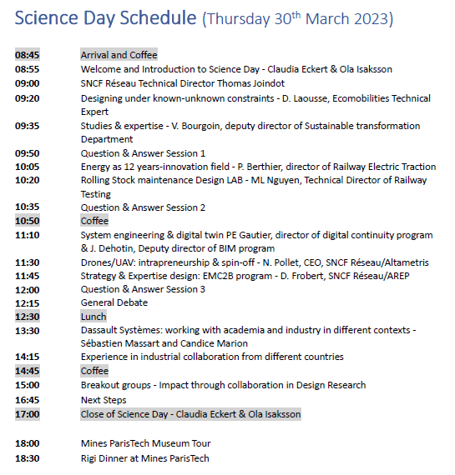

Slide 2
Impact from Design Research through collaboration?
We like to discuss and share the role of Design Research in the societal transformation.
What can we learn from eachother and from partners outside the acedemic community?

Slide 3
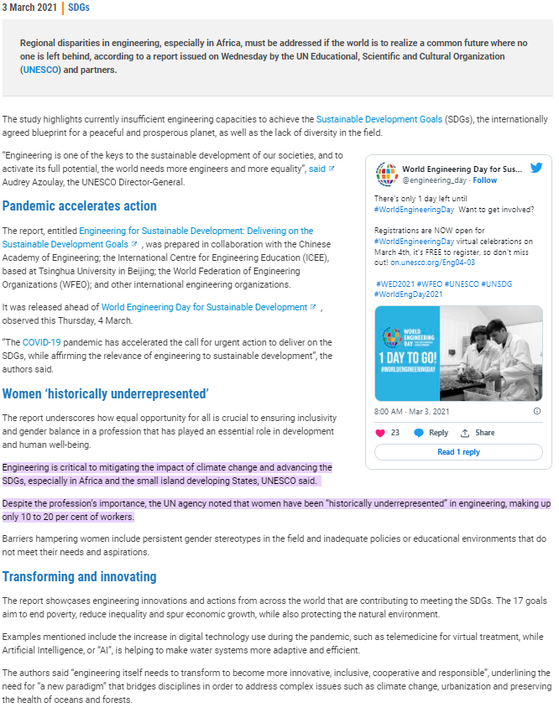
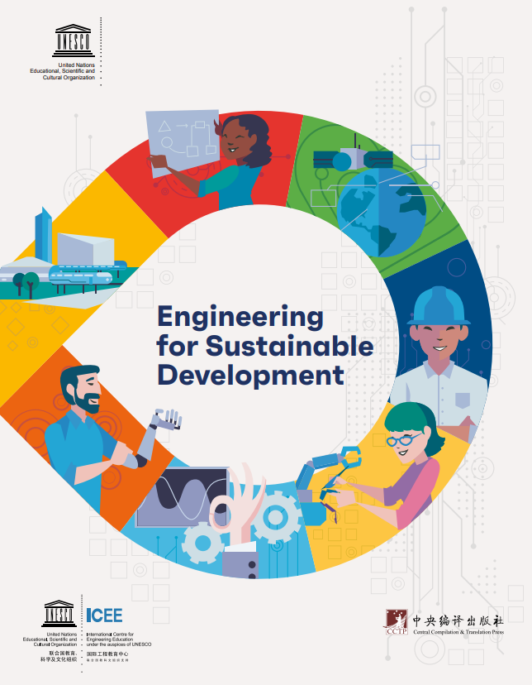
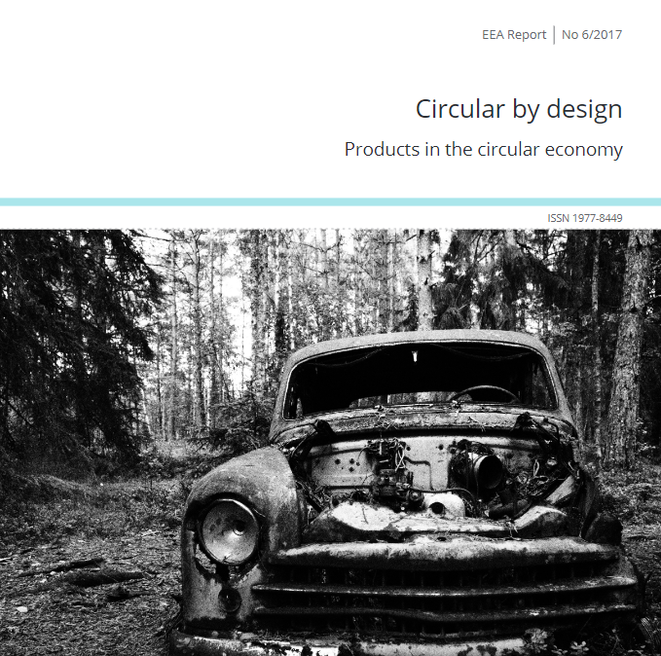
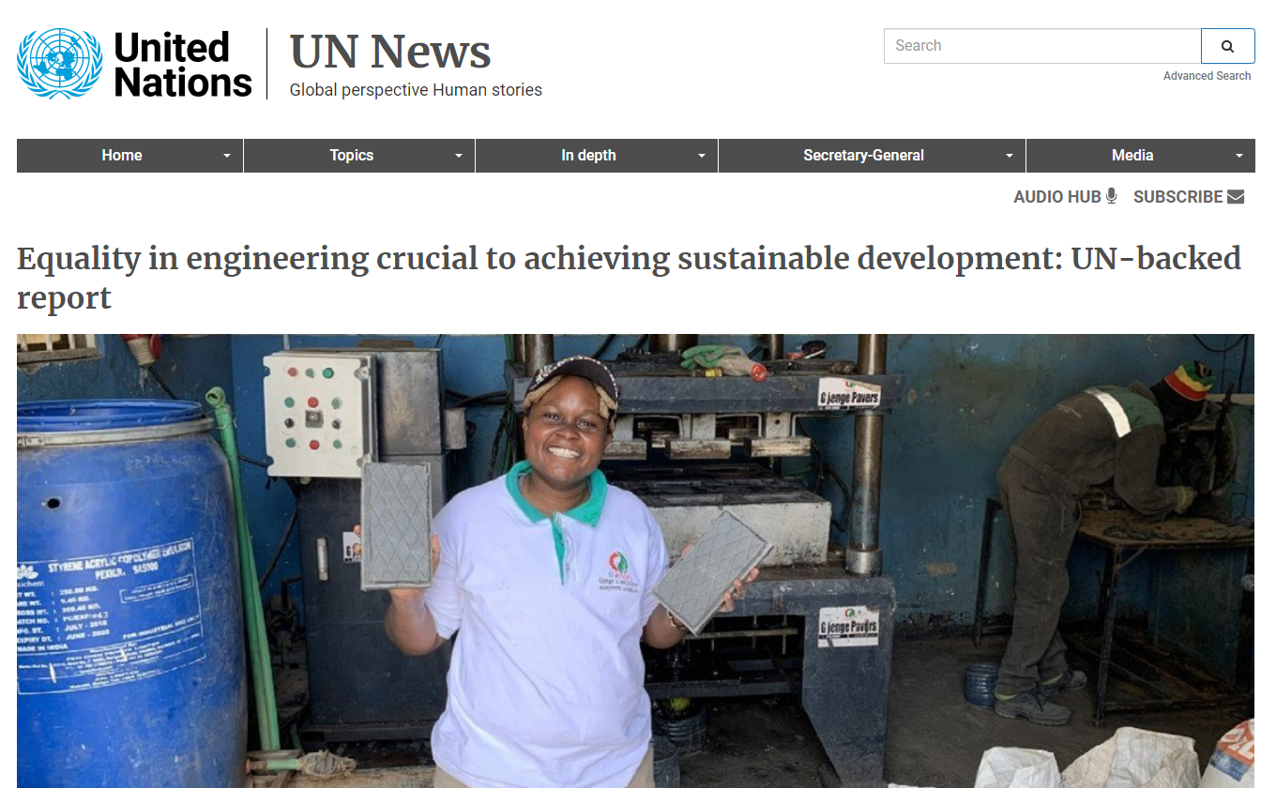
Engineering and Design Important for industry and societal transformation…
Or society is transforming – which impact needs and solutions for ”everyone” calling for new products, solutions, competences, technologies, perspectives…

Slide 4
QUESTION
Engineering Design Activities has a lot to offer to our world – how can we maximise the impact of our research?

Slide 5
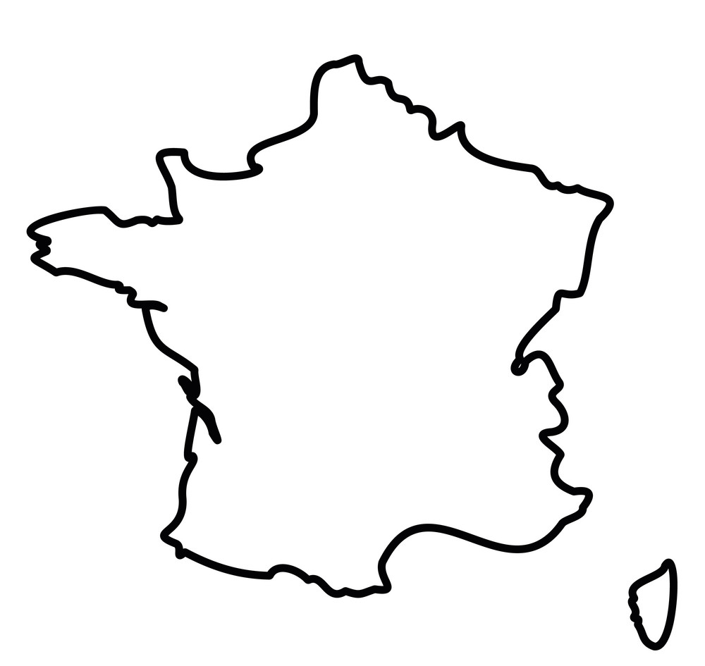
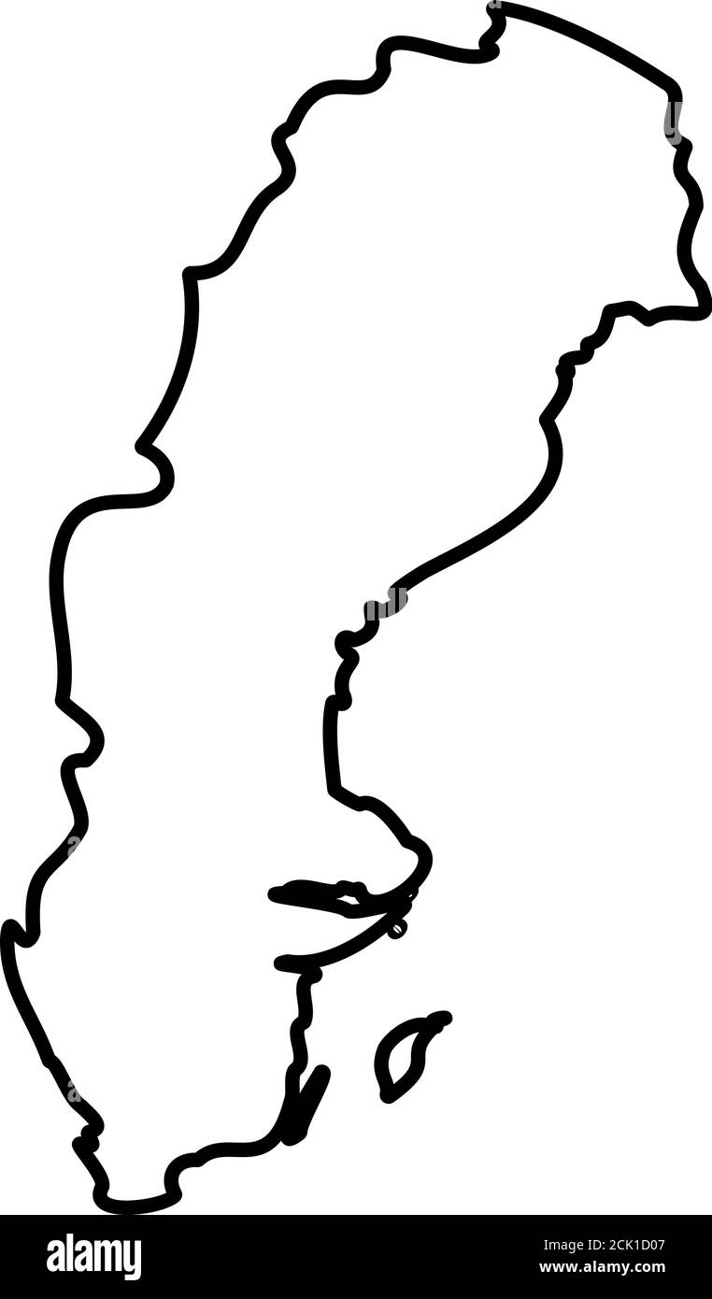
National and Regional Initiatives
Perspectives on Engineering Design Research
John Clarkson (UK)
Joshua Summers (US)
Julie Le Cardinal (France)
Iris Gräßler (German)
Ola Isaksson (Sweden)

Slide 6
Engineering Design Research in the UK John Clarkson
The Engineering and Physical Sciences Research Council (EPSRC) currently fund 73 grants to the value of £50.0M relating to Engineering Design
Doctoral Training Centres
Programme Grants
Managed Programmes
Fellowships
... a small proportion of this relates to this community, with other funding coming from the EU
There are a number of centres of excellence, and individual projects are typically collaborative, often within long-term partnerships
Research quality is measured by ’outputs’ and ’impact’ and can bring significant reward back to the University – engineering design can offer a real advantage in delivering tangible impact
Inclusive design research over the past twenty years has delivered measurable change and significant impact, following a decade of EPSRC funding

Slide 7
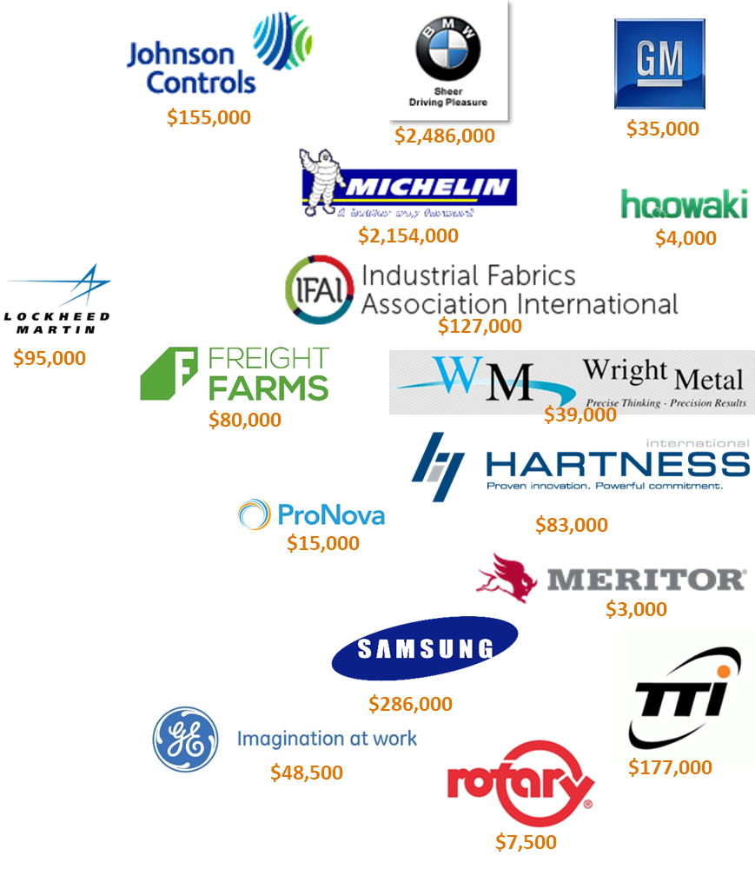
Engineering Design Research in USA Joshua Summers
Widely varied (as many models as there are faculty)
Graduate Students (MS Thesis & PHD) learn to do research
Stipends + Tuition + Faculty time + overhead → $85-100k per student/year
Federal Agencies fund some design research (NSF, ONR, DOD, DOC…)
Some fellowships (students secure own funding)
Most Research Assistants (funded on projects)
Companies fund some design research
Most fund small projects (3 month to 3 year)
Some include graduate coop/internships; a few “industry fellows”
Issues:
IP ownership, liability, contracts, different culture, equipment ownership
Lessons Learned:
Student projects → research projects → student projects
Trust is most important element
“what is problem” >> “I have your solution”
Collaborate (teams >> individuals)
Publishing is possible (if not focused on company core technology)
Never take “no” for an answer → money is never the block (just the excuse)
Decouple student research from student projects (provides more ownership of research)

Slide 8
Engineering Design Research in Sweden
Tight and informal collaboration between academia and industry.
E.g. Industrial PhD students, Adjunct Lecturers/Professors (mixed employment) – encuraged / sponsored by Funding bodies (Vinnova, KKS, Strategic Foundation, VR..)
Funding bodies expect industrial funding in cash OR/AND in work effort
~80% MSc thesis projects with industry placement
Funding for industrially focussed research via Innovation programmes
PhD students hired as employees – equivalent pay as entry level industry position
Co-publication with industrial participants common
Several different mechanisms for innovation to impact (innovation ecosystem)
National Graduate Schools – PhD students meet accross universities
PhD’s -> ~75% into industry, 25% to research
Typical success case?
Practitioners ”used” to academic research collaboration – enable accelerated pick-up of timely results – E.g. the Winqquist laboratory for digital product realization
The Product Development Academy in Sweden – sharing and coordinating national research education

Slide 9
Engineering Design Research in France
Tight collaboration between academia and industry.
Funding bodies expect industrial funding in cash OR/AND in work effort (e.g. ANR projects)
~80% Master thesis internships with industry placement (that can lead to ’CIFRE’ PhD theses)
CIFRE contract: PhD students hired as employees for 3 years – equivalent pay as entry level industry position
Industrial chairs very common: one or several companies that fund a research program with one or several universities for 5 years
Co-publication with industrial participants common
Alumni network involved in the research dynamics
PhD’s -> ~75% into industry, 25% to research
Typical success case?
Promotion of transfer to industry/start-up creation: example of Geeglee company ” Architect innovative design and manage trade-offs” from a PhD thesis
Notes:
What is the main mechanisms for Design Research in your country?
What is the incentives and policies dominate for design research?
Give an example of a typically successful research initiative?

Slide 10
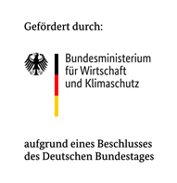
Engineering Design Research in Germany
Freedom of research and teaching anables individual preferences and focal points regarding topics, application reference and research methodology:
Fundamental research (DFG)
Application-orientied research: publically funded project consortia (e.g. EU, BMBF, BMWK et al.)
Bilateral research projects wit industrial partners
Bandwidth encourages mutual benefits (creative freedom, financing security, industrial constraints, personal professionalization of PhD-candidates)
the majority of the positions are financed by third-party funds that the professors raise
Notes:
regarding scientific skills as well as social skills
Communication, leadership, entrepreneurship

Slide 11
Partners of the chair for Product Creation
Industry
Civil Society
Science

Slide 12
Group work / coffee

Slide 13
CONTEXT AND PRACTICE
Experience
Situations
Challenges
Data
Engineering Design Research
Needs
Engineering Practice and
Society
People
Inventions
Policy
Demonstrations
Strategy
Standards
Funding
Intermediaries
Education
Training
Methods
Publications
Theory
Examina
People
KNOWLEDGE

Slide 14
Engineering Design Research
Engineering Practice and
Society
Study of practice and technology
Industry Driven Research
Fundamental and applied research
Knowledge and skills
People
Education/training
Product/Services/Tools/Service Providers
Intermediaries
Rules /regulations
Direction through funding
Policy
Funders
mechanisms

Slide 15
Engineering Design Research
Engineering Practice and
Society
Study of practice and technology
Industry Driven Research
Fundamental and applied research
Knowledge and skills
People
Education/training
Product/Services/Tools/Service Providers
Intermediaries
Rules /regulations
Direction through funding
Policy
Funders
mechanisms

Slide 16
Engineering Design Research
Engineering Practice and
Society
Study of practice and technology
Industry Driven Research
Fundamental and applied research
Knowledge and skills
People
Education/training
Product/Services/Tools/Service Providers
Intermediaries
Rules /regulations
Direction through funding
Policy
Funders
mechanisms

Slide 17
Engineering Design Research
Engineering Practice and
Society
Study of practice and technology
Industry Driven Research
Fundamental and applied research
Knowledge and skills
People
Education/training
Product/Services/Tools/Service Providers
Intermediaries
Rules /regulations
Direction through funding
Policy
Funders
mechanisms

Slide 18
Engineering Design Research
Engineering Practice and
Society
Study of practice and technology
Industry Driven Research
Fundamental and applied research
Knowledge and skills
People
Education/training
Product/Services/Tools/Service Providers
Intermediaries
Rules /regulations
Direction through funding
Policy
Funders
mechanisms

Slide 19
Engineering Design Research
Engineering Practice and
Society
Study of practice and technology
Industry Driven Research
Fundamental and applied research
Knowledge and skills
People
Education/training
Product/Services/Tools/Service Providers
Intermediaries
Rules /regulations
Direction through funding
Policy
Funders
mechanisms

Slide 20
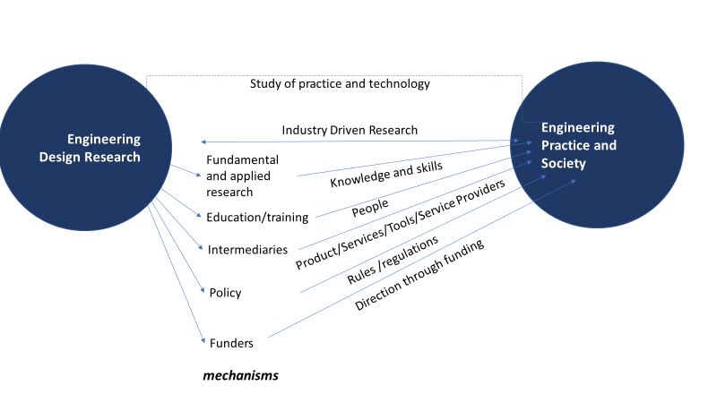
Group Discussion
Discuss each pathway
Fundamental/Applied research
Education and training
Intermediaries
Policy
Funding

Slide 21
Group Questions As a Design Society – for each pathway:
1. What are our current means of interacting and what impact are we (already) doing? Can we escalate these and do we need to team up with others? How?
2. What are we NOT doing, where we as design researchers can/should be more active? What would this “underutilised” way of interacting bring to research and practice?
Each group work FIRST on the Assigned Pathway, thereafter expand to the others.
Document on google docs
Gather for reporting 16:30!

Slide 22
Group work
Group 1 Kevin
Group 2 Joshua
Group 3 Julie
Group 4 John
Group 5 Iris

